Slide 1




Slide 2
Software Project Planning
After the finalization of SRS, we would estimate size, cost and development time
like to of the
project. Also, in many cases, customer may like to know the cost and development time even prior to finalization of the SRS.

Slide 3
Software Project Planning
In order to conduct a successful software project, we must understand:
Scope of work to be done
The risk to be incurred
The resources required
The task to be accomplished
The cost to be expended
The schedule to be followed

Slide 4
Software Project Planning
Software planning begins before technical work starts, continues as the software evolves from concept to reality, and culminates only when the software is retired.
Size estimation
Cost estimation
Development time
Resources requirements
Fig. 1: Activities during Software Project Planning
Project scheduling

Slide 5
Software Project Planning
Size Estimation
Lines of Code (LOC)
If LOC is simply a count of the number of lines then figure shown below contains 18 LOC .
When comments and blank lines are ignored, the program in figure 2 shown below contains 17 LOC.
Fig. 2: Function for sorting an array
1. | int. sort (int x[ ], int n)
2. | {
3. | int i, j, save, im1;
4. | /*This function sorts array x in ascending order */
5. | If (n<2) return 1;
6. | for (i=2; i<=n; i++)
7. | {
8. | im1=i-1;
9. | for (j=1; j<=im; j++)
10. | if (x[i] < x[j])
11. | {
12. | Save = x[i];
13. | x[i] = x[j];
14. | x[j] = save;
15. | }
16. | }
17. | return 0;
18. | }

Slide 6

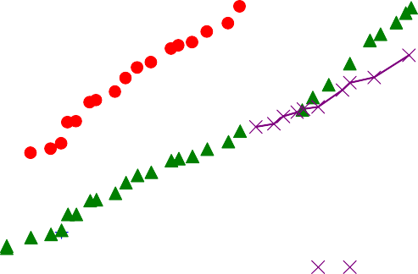
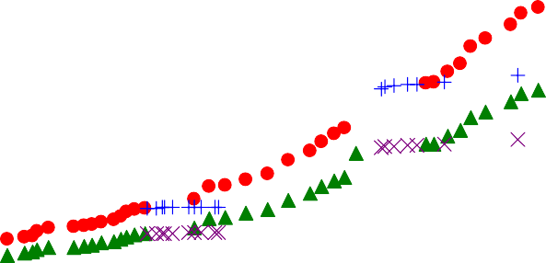
Software Project Planning
Growth of Lines of Code (LOC)
2,500,000
Total LOC ("wc -l") -- development releases Total LOC ("wc -l") -- stable releases
Total LOC uncommented -- development releases Total LOC uncommented -- stable releases
2,000,000
Total LOC
1,500,000
1,000,000
500,000
0
Jan 1993
Jun 1994
Oct 1995
Mar 1997
Jul 1998
Dec 1999
Apr 2001

Slide 7
Software Project Planning
Furthermore, if the main interest is the size of the program for specific functionality, it may be reasonable to include executable statements. The only executable statements in figure shown above are in lines 5-17 leading to a count of
13. The differences in the counts are 18 to 17 to 13. One can easily see the potential for major discrepancies for
large programs with many comments or programs written in language that allow a large number of descriptive but non-executable statement. Content has defined lines of code as:

Slide 8
Software Project Planning
“A line of code is any line of program text that is not a comment or blank line, regardless of the number of statements or fragments of statements on the line. This specifically includes all lines containing program header, declaration, and executable and non-executable statements”.
This is the predominant definition for lines of code used by researchers. By this definition, figure shown above has 17 LOC.

Slide 9
Software Project Planning
Function Count
Alan Albrecht while working for IBM, recognized the problem in size measurement in the 1970s, and developed a technique (which he called Function Point Analysis), which appeared to be a solution to the size measurement problem.

Slide 10
Software Project Planning
The principle of Albrecht’s function point analysis (FPA) is that a system is decomposed into functional units.
Inputs
Outputs
Enquiries
:
:
:
information entering the system information leaving the system
requests for instant access to information
information held within the system
information held by other system that is used by the system being analyzed.
Internal logical files
:
External interface files
:

Slide 11
Software Project Planning
The FPA functional units are shown in figure given below:
User
Inquiries
Other
applications
Inputs
ILF
User
EIF
Outputs
ILF: Internal logical files EIF: External interfaces
System
Fig. 3: FPAs functional units System

Slide 12
Software Project Planning
The five functional units are divided in two categories:
(i) Data function types
Internal Logical Files (ILF): A user identifiable group of logical related data or control information maintained within the system.
External Interface files (EIF): A user identifiable group of logically related data or control information referenced by the system, but maintained within another system. This means that EIF counted for one system, may be an ILF in another system.

Slide 13
Software Project Planning
Transactional function types
External Input (EI): An EI processes data or control information that comes from outside the system. The EI is an elementary process, which is the smallest unit of activity that is meaningful to the end user in the business.
External Output (EO): An EO is an elementary process that generate data or control information to be sent outside the system.
External Inquiry (EQ): An EQ is an elementary process that is made up to an input-output combination that results in data retrieval.

Slide 14
Software Project Planning
Special features
Function point approach is independent of the language, tools, or methodologies used for implementation; i.e. they do not take into consideration programming languages, data base management systems, processing hardware or any other data base technology.
Function points can be estimated from requirement specification or design specification, thus making it possible to estimate development efforts in early phases of development.

Slide 15
Software Project Planning
Function points are directly linked to the statement of requirements; any change of requirements can easily be followed by a re-estimate.
Function points are based on the system user’s external view of the system, non-technical users of the software system have a better understanding of what function points are measuring.

Slide 16
Software Project Planning
Counting function points
Functional Units | Weighting factors
 | Low | Average | High
External Inputs (EI) | 3 | 4 | 6
External Output (EO) | 4 | 5 | 7
External Inquiries (EQ) | 3 | 4 | 6
External logical files (ILF) | 7 | 10 | 15
External Interface files (EIF) | 5 | 7 | 10
Table 1 : Functional units with weighting factors

Slide 17
Software Project Planning
Table 2: UFP calculation table
Functional Units |  | Count Complexity |  |  | Complexity Totals |  |  | Functional Unit Totals
External Inputs (EIs) |  | Low x 3 Average x 4 |  | = =
 |  |  | High x 6 | =
External Outputs (EOs) |  | Low x 4 Average x 5 |  | = =
 |  |  | High x 7 | =
External Inquiries (EQs) |  | Low x 3 Average x 4 |  | = =
 |  |  | High x 6 | =
External logical Files (ILFs) |  | Low x 7 Average x 10 High x 15 |  | = = =
External Interface Files (EIFs) |  | Low x 5 Average x 7 |  | = =
 |  |  | High x 10 | =
Total Unadjusted Function Point Count

Slide 18
Software Project Planning
The weighting factors are identified for all functional units and multiplied with the functional units accordingly. The procedure for the calculation of Unadjusted Function Point (UFP) is given in table shown above.

Slide 19
Software Project Planning
The procedure for the calculation of UFP in mathematical form is given below:
5 3
UFP = ∑∑ Z_{ij} w_{ij}
i=1 J =1
Where i indicate the row and j indicates the column of Table 1
W_{ij} : It is the entry of the i^{th} row and j^{th} column of the table 1
Zij : It is the count of the number of functional units of Type i that have been classified as having the complexity corresponding to column j.

Slide 20
Software Project Planning
Organizations that use function point methods develop a criterion for determining whether a particular entry is Low, Average or High. Nonetheless, the determination of complexity is somewhat subjective.
FP = UFP * CAF
Where CAF is complexity adjustment factor and is equal to [0.65 +
0.01 x ΣF_{i}]. The F_{i} (i=1 to 14) are the degree of influence and are based on responses to questions noted in table 3.

Slide 21
Software Project Planning
Table 3 : Computing function points.
Rate each factor on a scale of 0 to 5.
0 1 2 3
4
5
No Influence
Average
Essential
Incidental Moderate Significant
Number of factors considered ( F_{i} )
Does the system require reliable backup and recovery ?
Is data communication required ?
Are there distributed processing functions ?
Is performance critical ?
Will the system run in an existing heavily utilized operational environment ?
Does the system require on line data entry ?
Does the on line data entry require the input transaction to be built over multiple screens or operations ?
Are the master files updated on line ?
Is the inputs, outputs, files, or inquiries complex ?
Is the internal processing complex ?
Is the code designed to be reusable ?
Are conversion and installation included in the design ?
Is the system designed for multiple installations in different organizations ?
Is the application designed to facilitate change and ease of use by the user ?

Slide 22
Software Project Planning
Functions points may compute the following important metrics:
Productivity Quality | = = | FP / persons-months Defects / FP
Cost | = | Rupees / FP
Documentation | = | Pages of documentation per FP
These metrics are controversial and are not universally acceptable. There are standards issued by the International Functions Point User Group (IFPUG, covering the Albrecht method) and the United Kingdom Function Point User Group (UFPGU, covering the MK11 method). An ISO standard for function point method is also being developed.

Slide 23
Software Project Planning
Example: 4.1
Consider a project with the following functional units:
Number of user inputs Number of user outputs Number of user enquiries Number of user files
Number of external interfaces
= 50
= 40
= 35
= 06
= 04
Assume all complexity adjustment factors and weighting factors are average. Compute the function points for the project.

Slide 24
Software Project Planning
Solution
We know
5 3
UFP = ∑∑ Z_{ij} w_{ij}
i=1 J =1
UFP = 50 x 4 + 40 x 5 + 35 x 4 + 6 x 10 + 4 x 7
= 200 + 200 + 140 + 60 + 28 = 628
CAF = (0.65 + 0.01 ΣF_{i})
= (0.65 + 0.01 (14 x 3)) = 0.65 + 0.42 = 1.07 FP = UFP x CAF
= 628 x 1.07 = 672

Slide 25
Software Project Planning
Example:4.2
An application has the following:
10 low external inputs, 12 high external outputs, 20 low
internal logical files, 15 high external interface files, 12 average external inquiries, and a value of complexity
adjustment factor of 1.10.
What are the unadjusted and adjusted function point counts ?

Slide 26
Software Project Planning
Solution
Unadjusted function point counts may be calculated using as:
5 3
UFP = ∑∑ Z_{ij} w_{ij}
i=1 J =1
= 10 x 3 + 12 x 7 + 20 x 7 + 15 + 10 + 12 x 4
= 30 + 84 +140 + 150 + 48
= 452
FP
= UFP x CAF
= 452 x 1.10 = 497.2.

Slide 27
Software Project Planning
Example: 4.3
Consider a project with the following parameters.
External Inputs:
10 with low complexity (b)15 with average complexity
(c) 17 with high complexity
External Outputs:
6 with low complexity (b)13 with high complexity
External Inquiries:
3 with low complexity
4 with average complexity
2 high complexity

Slide 28
Software Project Planning
Internal logical files:
2 with average complexity (b)1 with high complexity
External Interface files:
9 with low complexity
In addition to above, system requires
Significant data communication
Performance is very critical
Designed code may be moderately reusable
System is not designed for multiple installation in different organizations.
Other complexity adjustment factors are treated as average. Compute the function points for the project.
CAF= 1.06

Slide 29
Software Project Planning
Solution: Unadjusted function points may be counted using table 2
Functional Units | Count | Complexity |  | Complexity Totals |  |  | Functional Unit Totals
External Inputs | 10 15 | Low x 3 Average x 4 | = = |  | 30 60
(EIs) | 17 | High x 6 | = |  | 102 | 192
External Outputs (EOs) | 6 0 13 | Low x 4 Average x 5 High x 7 | = = = |  | 24 0 91 | 115
External Inquiries (EQs) | 3 4 2 | Low x 3 Average x 4 High x 6 | = = = |  | 9 16 12 | 37
External logical | 0 2 | Low x 7 Average x 10 | = = |  | 0 20
Files (ILFs) | 1 | High x 15 | = |  | 15 | 35
External | 9 | Low x 5 Average x 7 High x 10 | = = = |  | 45
Interface | 0 |  |  |  | 0
Files (EIFs) | 0 |  |  |  | 0 | 45
 | Total Unadjusted Function Point Count |  |  |  |  |  | 424

Slide 30
Software Project Planning
FP = UFP x CAF
= 424 x 1.06
= 449.44
Hence FP = 449

Slide 31
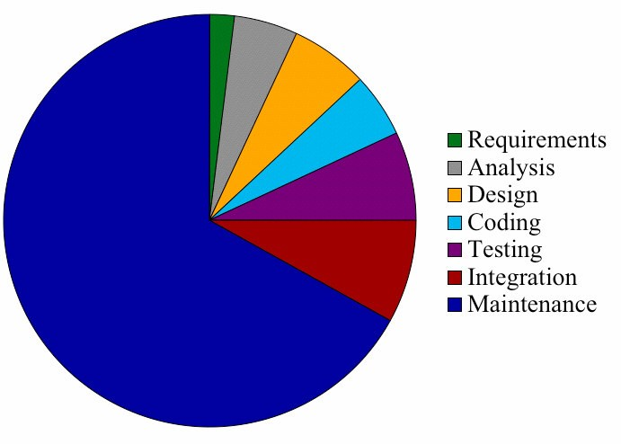
Software Project Planning
Relative Cost of Software Phases

Slide 32
Software Project Planning
Cost Estimation
A number of estimation techniques have been developed and are having following attributes in common :
Project scope must be established in advance
Software metrics are used as a basis from which estimates are made
The project is broken into small pieces which are estimated individually
To achieve reliable cost and schedule estimates, a number of options arise:
Delay estimation until late in project
Use simple decomposition techniques to generate project cost and schedule estimates
Develop empirical models for estimation
Acquire one or more automated estimation tools

Slide 33
Software Project Planning
MODELS
Static, Single Variable Models
Static, Multivariable Models

Slide 34
Software Project Planning
Static, Single Variable Models
Methods using this model use an equation to estimate the desired values such as cost, time, effort, etc. They all depend on the same variable used as predictor (say, size). An example of the most common equations is :
C = a L^{b}
(i)
C is the cost, L is the size and a,b are constants
E = 1.4 L^{0.93} DOC = 30.4 L^{0.90} D = 4.6 L^{0.26}
Effort (E in Person-months), documentation (DOC, in number of pages) and duration (D, in months) are calculated from the number of lines of code (L, in thousands of lines) used as a predictor.

Slide 35
Software Project Planning
Static, Multivariable Models
These models are often based on equation (i), they actually depend on several variables representing various aspects of the software development environment, for example method used, user participation, customer oriented changes, memory constraints, etc.
E D
= 5.2 L^{0.91}
= 4.1 L^{0.36}
The productivity index uses 29 variables which are found to be highly correlated to productivity as follows:
Ι = ∑W_{i} X_{i}
i=1
29

Slide 36
Software Project Planning
Example: 4.4
Compare the Walston-Felix model with the SEL model on a software development expected to involve 8 person-years of effort.
Calculate the number of lines of source produced.
Calculate the duration of the development. (c)Calculate the productivity in LOC/PY
code that can be

Slide 37
Software Project Planning
Solution
The amount of manpower involved = 8 PY = 96 person-months
(a) Number of lines of source code can be obtained by reversing equation to give:
L = (E/a)^{1/b}
Then
L(SEL) = (96/1.4)^{1/0.93} = 94264 LOC L(SEL) = (96/5.2)^{1/0.91} = 24632 LOC.

Slide 38
Software Project Planning
Duration in months can be calculated by means of equation D(SEL) = 4.6 (L)^{0.26}
= 4.6 (94.264)^{0.26} = 15 months D(W-F) = 4.1 L^{0.36}
= 4.1(24.632)^{0.36} = 13 months
Productivity is the lines of code produced per person/month (year)
P(SEL) = ⁹⁴²⁶⁴ = 11783 LOC / Person − Years
8
P(W − F ) = ²⁴⁶³² = 3079 LOC / Person − Years
8

Slide 39
Software Project Planning
The Constructive Cost Model (COCOMO)
Constructive Cost model (COCOMO)
Basic Intermediate Detailed
Model proposed by
B. W. Boehm’s through his book
Software Engineering Economics in 1981

Slide 40
Software Project Planning
COCOMO applied to
Semidetached mode
Organic mode
Embedded mode

Slide 41
Software Project Planning
Mode | Project size | Nature of Project | Innovation | Deadline of the project | Development Environment
Organic | Typically 2-50 KLOC | Small size project, experienced developers in the familiar environment. For example, pay roll, inventory projects etc. | Little | Not tight | Familiar & In house
Semi detached | Typically 50-300 KLOC | Medium size project, Medium size team, Average previous experience on similar project. For example: Utility systems like compilers, database systems, editors etc. | Medium | Medium | Medium
Embedded | Typically over 300 KLOC | Large project, Real time systems, Complex interfaces, Very little previous experience. For example: ATMs, Air Traffic Control etc. | Significant | Tight | Complex Hardware/ customer Interfaces required
Table 4: The comparison of three COCOMO modes

Slide 42
Boehm’s definition of organic, semidetached, and embedded systems:
Organic – A software project is said to be an organic type if the team size required is adequately small, the problem is well understood and has been solved in the past and also the team members have a nominal experience regarding the problem.
Semi-detached – A software project is said to be a Semi-detached type if the vital characteristics such as team-size, experience, knowledge of the various programming environment lie in between that of organic and Embedded. The projects classified as Semi-Detached are comparatively less familiar and difficult to develop compared to the organic ones and require more experience and better guidance and creativity. Eg: Compilers or different Embedded Systems can be considered of Semi-Detached type.
Embedded – A software project with requiring the highest level of complexity, creativity, and experience requirement fall under this category. Such software requires a larger team size than the other two models and also the developers need to be sufficiently experienced and creative to develop such complex models.

Slide 43
Software Project Planning
Basic Model
Basic COCOMO model takes the form
E = a (KLOC)^{bb}
b
D = c (E)
d
b
b
where E is effort applied in Person-Months, and D is the development time in months. The coefficients a_{b}, b_{b}, c_{b} and d_{b} are given in table 4 (a).

Slide 44
Software Project Planning
Software Project | a_{b} | b_{b} | c_{b} | d_{b}
Organic | 2.4 | 1.05 | 2.5 | 0.38
Semidetached | 3.0 | 1.12 | 2.5 | 0.35
Embedded | 3.6 | 1.20 | 2.5 | 0.32
Table 4(a): Basic COCOMO coefficients

Slide 45
Software Project Planning
When effort and development time are known, the average staff size to complete the project may be calculated as:
E
Average staff size (SS ) =
Persons
D
When project size is known, the productivity
level may be
calculated as:
Productivity (P) = ^{KLOC} KLOC / PM
E

Slide 46
Software Project Planning
Example: 4.5
Suppose that a project was estimated to be 400 KLOC. Calculate the effort and development time for each of the three modes i.e., organic, semidetached and embedded.

Slide 47
Software Project Planning
Solution
The basic COCOMO equation take the form:
b_{b}
E = a_{b} (KLOC)
D = c (KLOC)^{db}
b
Estimated size of the project = 400 KLOC
(i) Organic mode
E = 2.4(400)^{1.05} = 1295.31 PM
D = 2.5(1295.31)^{0.38} = 38.07 PM

Slide 48
Software Project Planning
Semidetached mode
E = 3.0(400)^{1.12} = 2462.79 PM
D = 2.5(2462.79)^{0.35} = 38.45 PM
Embedded mode
E = 3.6(400)^{1.20} = 4772.81 PM
D = 2.5(4772.8)^{0.32} = 38 PM

Slide 49
Software Project Planning
Example: 4.6
A project size
of 200 KLOC is to be developed. Software
development team has average experience on similar type of projects. The project schedule is not very tight. Calculate the effort, development time, average staff size and productivity of the project.

Slide 50
Software Project Planning
Solution
The semi-detached mode is the most appropriate mode; keeping in view the size, schedule and experience of the development team.
E = 3.0(200)^{1.12} = 1133.12 PM
D = 2.5(1133.12)^{0.35} = 29.3 PM
Hence
E
Average staff size (SS ) =
Persons
D
= ^{1133.12} = 38.67Persons
29.3

Slide 51
Software Project Planning
KLOC
200
Productivity
=
=
= 0.1765 KLOC / PM
E 1133.12
P = 176 LOC / PM

Slide 52
Software Project Planning
Intermediate Model
Cost drivers
Product Attributes
Required s/w reliability
Size of application database
Complexity of the product Hardware Attributes
Run time performance constraints
Memory constraints
Virtual machine volatility
Turnaround time
(ii)

Slide 53
Software Project Planning
Personal Attributes
Analyst capability
Programmer capability
Application experience
Virtual m/c experience
Programming language experience
Project Attributes
Modern programming practices
Use of software tools
Required development Schedule

Slide 54
Software Project Planning
Multipliers of different cost drivers
Cost Drivers | RATINGS
 | Very low | Low | Nominal | High | Very high | Extra high
Product Attributes
RELY | 0.75 | 0.88 | 1.00 | 1.15 | 1.40 | --
DATA | -- | 0.94 | 1.00 | 1.08 | 1.16 | --
CPLX | 0.70 | 0.85 | 1.00 | 1.15 | 1.30 | 1.65
Computer Attributes
TIME | -- | -- | 1.00 | 1.11 | 1.30 | 1.66
STOR | -- | -- | 1.00 | 1.06 | 1.21 | 1.56
VIRT | -- | 0.87 | 1.00 | 1.15 | 1.30 | --
TURN | -- | 0.87 | 1.00 | 1.07 | 1.15 | --

Slide 55
Software Project Planning
Cost Drivers | RATINGS
 | Very low | Low | Nominal | High | Very high | Extra high
Personnel Attributes
ACAP | 1.46 | 1.19 | 1.00 | 0.86 | 0.71 | --
AEXP | 1.29 | 1.13 | 1.00 | 0.91 | 0.82 | --
PCAP | 1.42 | 1.17 | 1.00 | 0.86 | 0.70 | --
VEXP | 1.21 | 1.10 | 1.00 | 0.90 | -- | --
LEXP | 1.14 | 1.07 | 1.00 | 0.95 | -- | --
Project Attributes
MODP | 1.24 | 1.10 | 1.00 | 0.91 | 0.82 | --
TOOL | 1.24 | 1.10 | 1.00 | 0.91 | 0.83 | --
SCED | 1.23 | 1.08 | 1.00 | 1.04 | 1.10 | --
Table 5: Multiplier values for effort calculations

Slide 56
Software Project Planning
Intermediate COCOMO equations
E = a (KLOC)^{bi} * EAF
i
D = c (E)^{di}
i
Project | a_{i} | b_{i} | c_{i} | d_{i}
Organic | 3.2 | 1.05 | 2.5 | 0.38
Semidetached | 3.0 | 1.12 | 2.5 | 0.35
Embedded | 2.8 | 1.20 | 2.5 | 0.32
Table 6: Coefficients for intermediate COCOMO

Slide 57
Software Project Planning
Detailed COCOMO Model
Detailed COCOMO
Phase-Sensitive effort multipliers
Three level product hierarchy
Modules subsystem
Cost drivers
design & test
System level
Manpower allocation for each phase

Slide 58
Software Project Planning
Development Phase
Plan / Requirements
EFFORT DEVELOPMENT TIME
% depend on mode & size
: 6% to 8%
: 10% to 40%

Slide 59
Software Project Planning
Design
Effort Time
:
:
16% to 18%
19% to 38%
Programming
Effort Time
:
:
48% to 68%
24% to 64%
Integration & Test
Effort Time
:
:
16% to 34%
18% to 34%

Slide 60
Software Project Planning
Principle of the effort estimate
Size equivalent
As the software might be partly developed from software already existing (that is, re-usable code), a full development is not always required. In such cases, the parts of design document (DD%), code (C%) and integration (I%) to be modified are estimated. Then, an adjustment factor, A, is calculated by means of the following equation.
A = 0.4 DD + 0.3 C + 0.3 I
The size equivalent is obtained by
S (equivalent) = (S x A) / 100
E_{p} = μ _{p} E
D_{p} = τ _{p} D

Slide 61
Software Project Planning
Lifecycle Phase Values of μ _{p}
Mode & Code Size | Plan & Requirements | System Design | Detailed Design | Module Code & Test | Integration & Test
Organic Small S≈2 | 0.06 | 0.16 | 0.26 | 0.42 | 0.16
Organic medium S≈32 | 0.06 | 0.16 | 0.24 | 0.38 | 0.22
Semidetached medium S≈32 | 0.07 | 0.17 | 0.25 | 0.33 | 0.25
Semidetached large S≈128 | 0.07 | 0.17 | 0.24 | 0.31 | 0.28
Embedded large S≈128 | 0.08 | 0.18 | 0.25 | 0.26 | 0.31
Embedded extra large S≈320 | 0.08 | 0.18 | 0.24 | 0.24 | 0.34
Table 7 : Effort and schedule fractions occurring in each phase of the lifecycle

Slide 62
Software Project Planning
Lifecycle Phase Values of τ _{p}
Mode & Code Size | Plan & Requirements | System Design | Detailed Design | Module Code & Test | Integration & Test
Organic Small S≈2 | 0.10 | 0.19 | 0.24 | 0.39 | 0.18
Organic medium S≈32 | 0.12 | 0.19 | 0.21 | 0.34 | 0.26
Semidetached medium S≈32 | 0.20 | 0.26 | 0.21 | 0.27 | 0.26
Semidetached large S≈128 | 0.22 | 0.27 | 0.19 | 0.25 | 0.29
Embedded large S≈128 | 0.36 | 0.36 | 0.18 | 0.18 | 0.28
Embedded extra large S≈320 | 0.40 | 0.38 | 0.16 | 0.16 | 0.30
Table 7 : Effort and schedule fractions occurring in each phase of the lifecycle

Slide 63
Software Project Planning
Distribution of software life cycle:
Requirement and product design
Plans and requirements (b)System design
Detailed Design
Detailed design
Code & Unit test
Module code & test
Integrate and Test
Integrate & Test

Slide 64
Software Project Planning
Example: 4.7
A new project with estimated 400 KLOC embedded system has to be developed. Project manager has a choice of hiring from two pools of
developers: Very highly capable with very little experience in the
programming language being used Or
Developers of low quality but a lot of experience with the programming language. What is the impact of hiring all developers from one or the other pool ?

Slide 65
Software Project Planning
Solution
This is the COCOMO.
Hence
case of embedded mode and model is intermediate
E = a (KLOC)^{di}
i
= 2.8 (400)^{1.20} = 3712 PM
Case I: Developers are very highly capable with very little experience in the programming being used.
EAF = 0.82 x 1.14 = 0.9348
E = 3712 x .9348 = 3470 PM
D = 2.5 (3470)^{0.32} = 33.9 M

Slide 66
Software Project Planning
Case II: Developers are of low quality but lot of experience with the programming language being used.
EAF = 1.29 x 0.95 = 1.22
E = 3712 x 1.22 = 4528 PM
D = 2.5 (4528)^{0.32} = 36.9 M
Case II requires more effort and time. Hence, low quality developers with lot of programming language experience could not match with the performance of very highly capable developers with very litter experience.

Slide 67
Software Project Planning
Example: 4.8
Consider a project to develop a full screen editor. The major components identified are:
Screen edit
Command Language Interpreter
File Input & Output
Cursor Movement
Screen Movement
The size of these are estimated to be 4k, 2k, 1k, 2k and 3k delivered source code lines. Use COCOMO to determine
Overall cost and schedule estimates (assume values for different cost drivers, with at least three of them being different from 1.0)
Cost & Schedule estimates for different phases.

Slide 68
Software Project Planning
Solution
Size of five modules are:
Screen edit
Command language interpreter File input and output
Cursor movement Screen movement
Total
= 4 KLOC
= 2 KLOC
= 1 KLOC
= 2 KLOC
= 3 KLOC
= 12 KLOC

Slide 69
Software Project Planning
Let us assume that significant cost drivers are
Required software reliability is high, i.e.,1.15
Product complexity is high, i.e.,1.15
Analyst capability is high, i.e.,0.86
Programming language experience is low,i.e.,1.07
All other drivers are nominal
EAF = 1.15x1.15x0.86x1.07 = 1.2169

Slide 70
Software Project Planning
(a) The initial effort estimate for the project is obtained from the following equation
E = a_{i} (KLOC)^{bi} x EAF
= 3.2(12)^{1.05} x 1.2169 = 52.91 PM
D = C_{i}(E)^{di}
= 2.5(52.91)^{0.38} = 11.29 M
Development time
(b) Using the following equations and referring Table 7, phase wise cost and schedule estimates can be calculated.
E_{p} = μ _{p} E
D_{p} = τ _{p} D

Slide 71
Software Project Planning
Since size is only 12 KLOC, it is an organic small model. Phase wise effort distribution is given below:
System Design Detailed Design Module Code & Test Integration & Test
= 0.16 x 52.91 = 8.465 PM
= 0.26 x 52.91 = 13.756 PM
= 0.42 x 52.91 = 22.222 PM
= 0.16 x 52.91 = 8.465 Pm
Now Phase wise development time duration is
System Design Detailed Design Module Code & Test Integration & Test
= 0.19 x 11.29 = 2.145 M
= 0.24 x 11.29 = 2.709 M
= 0.39 x 11.29 = 4.403 M
= 0.18 x 11.29 = 2.032 M

Slide 72
Software Project Planning
COCOMO-II
The following categories of applications / projects are identified by COCOMO-II and are shown in fig. 4 shown below:
End user programming | Application generators & composition aids | Infrastructure
 | Application composition
 | System integration
Fig. 4 : Categories of applications / projects

Slide 73
Software Project Planning
Stage No | Model Name | Application for the types of projects | Applications
Stage I | Application composition estimation model | Application composition | In addition to application composition type of projects, this model is also used for prototyping (if any) stage of application generators, infrastructure & system integration.
Stage II | Early design estimation model | Application generators, infrastructure & system integration | Used in early design stage of a project, when less is known about the project.
Stage III | Post architecture estimation model | Application generators, infrastructure & system integration | Used after the completion of the detailed architecture of the project.
Table 8: Stages of COCOMO-II

Slide 74
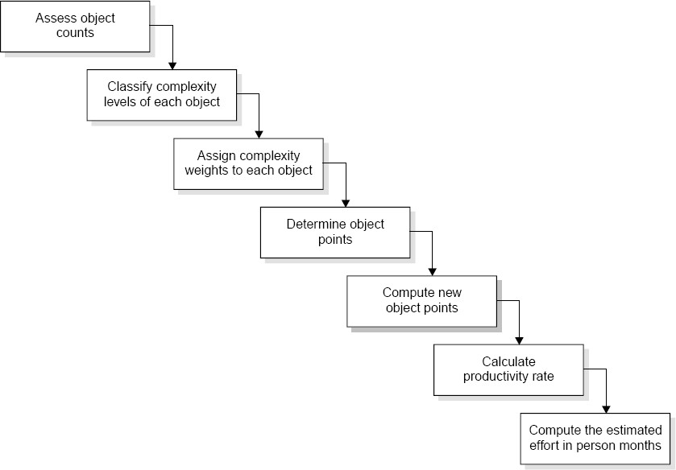
Software Project Planning
Application Composition Estimation Model
Fig.5: Steps f_{rd}or the estimation of effort in person months
Software Engineering (3 ed.), By K.K Aggarwal & Yogesh Singh, Copyright © New Age International Publishers, 2007
75

Slide 75
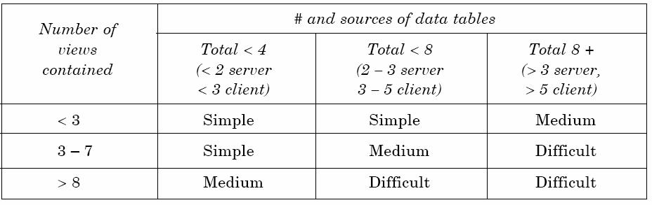
Software Project Planning
Assess object counts: Estimate the number of screens, reports and 3 GL components that will comprise this application.
Classification of complexity levels: We have to classify each object instance into simple, medium and difficult complexity levels depending on values of its characteristics.
Table 9 (a): For screens

Slide 76
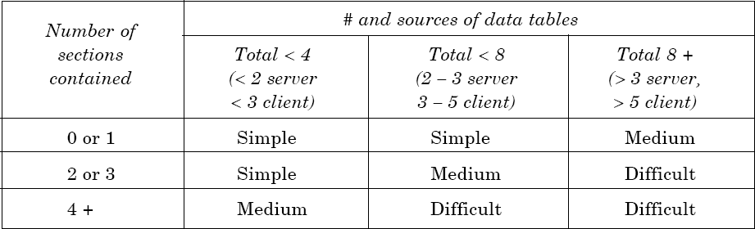
Software Project Planning
Table 9 (b): For reports

Slide 77
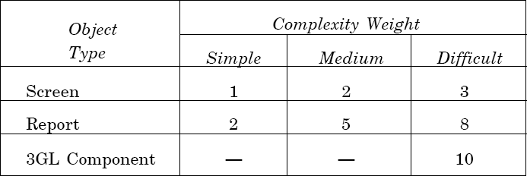
Software Project Planning
iii. Assign complexity weight to each object : The weights are used for three object types i.e., screen, report and 3GL components using the Table 10.
Table 10: Complexity weights for each level

Slide 78
Software Project Planning
Determine object points: Add all the weighted object instances to get one number and this known as object-point count.
Compute new object points: We have to estimate the percentage of reuse to be achieved in a project. Depending on the percentage reuse, the new object points (NOP) are computed.
(object points) * (100-%reuse)
NOP = -------------------------------------------
100
NOP are the object points that will need to be developed and differ from the object point count because there may be reuse.

Slide 79
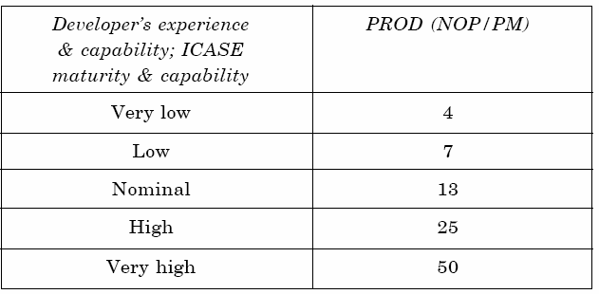
Software Project Planning
vi. Calculation
calculated as:
of productivity rate: The productivity rate can be
Productivity rate (PROD) = NOP/Person month
Table 11: Productivity values

Slide 80
Software Project Planning
vii. Compute the effort in Persons-Months: When PROD is known, we may estimate effort in Person-Months as:
NOP
Effort in PM = ------------
PROD

Slide 81
Software Project Planning
Example: 4.9
Consider a database application project with the following characteristics:
The application has 4 screens with 4 views each and 7 data tables for 3 servers and 4 clients.
The application may generate two report of 6 sections each from 07 data tables for two server and 3 clients. There is 10% reuse of object points.
The developer’s experience and capability in the similar environment is low. The maturity of organization in terms of capability is also low. Calculate the object point count, New object points and effort to develop such a project.

Slide 82
Software Project Planning
Solution
This project comes under the category of application composition estimation model.
Number of screens = 4 with 4 views each Number of reports = 2 with 6 sections each
From Table 9 we know that each screen will be of medium complexity and each report will be difficult complexity.
Using Table 10 of complexity weights, we may calculate object point count.
= 4 x 2 + 2 x 8 = 24
24 * (100 -10)
NOP = -------------------- = 21.6
100

Slide 83
Software Project Planning
Table 11 gives the low value of productivity (PROD) i.e. 7.
NOP
Efforts in PM = -----------
PROD
21.6
Efforts = ----------- = 3.086 PM
7

Slide 84
Software Project Planning
The Early Design Model
The COCOMO-II models use the base equation of the form
PM_{nominal} = A * (size)^{B}
where
PM_{nominal} = Effort of the project in person months
A = Constant representing the nominal productivity, provisionally set to 2.5
B = Scale factor
Size = Software size

Slide 85
Software Project Planning
Scale factor |  | Explanation |  |  | Remarks
Precedentness |  | Reflects the previous experience on similar projects. This is applicable to individuals & organization both in terms of expertise & experience |  |  | Very low means no previous experiences, Extra high means that organization is completely familiar with this application domain.
Development flexibility |  | Reflect the degree of flexibility in the development process. |  |  | Very low means a well defined process is used. Extra high means that the client gives only general goals.
Architecture/ resolution | Risk | Reflect the degree analysis carried out. | of | risk | Very low means very little analysis and Extra high means complete and through risk analysis.
Cont…
Table 12: Scaling factors required for the calculation of the value of B

Slide 86
Software Project Planning
Scale factor | Explanation | Remarks
Team cohesion | Reflects the team management skills. | Very low means no previous experiences, Extra high means that organization is completely familiar with this application domain.
Process maturity | Reflects the process maturity of the organization. Thus it is dependent on SEI-CMM level of the organization. | Very low means organization has no level at all and extra high means organization is related as highest level of SEI-CMM.
Table 12: Scaling factors required for the calculation of the value of B

Slide 87
Software Project Planning
Scaling factors | Very low | Low | Nominal | High | Very high | Extra high
Precedent ness | 6.20 | 4.96 | 3.72 | 2.48 | 1.24 | 0.00
Development flexibility | 5.07 | 4.05 | 3.04 | 2.03 | 1.01 | 0.00
Architecture/ Risk resolution | 7.07 | 5.65 | 4.24 | 2.83 | 1.41 | 0.00
Team cohesion | 5.48 | 4.38 | 3.29 | 2.19 | 1.10 | 0.00
Process maturity | 7.80 | 6.24 | 4.68 | 3.12 | 1.56 | 0.00
Table 13: Data for the Computation of B
The value of B can be calculated as:
B=0.91 + 0.01 * (Sum of rating on scaling factors for the project)

Slide 88
Software Project Planning
Early design cost drivers
There are seven early design cost drivers and are given below:
Product Reliability and Complexity (RCPX)
Required Reuse (RUSE)
Platform Difficulty (PDIF)
Personnel Capability (PERS)
Personnel Experience (PREX)
Facilities (FCIL)
Schedule (SCED)

Slide 89
Software Project Planning
Post architecture cost drivers
There are 17 cost drivers in the Post Architecture model. These are rated on a scale of 1 to 6 as given below :
The list of seventeen cost drivers is given below :
Reliability Required (RELY)
Database Size (DATA)
Product Complexity (CPLX)
Required Reusability (RUSE)

Slide 90
Software Project Planning
Documentation (DOCU)
Execution Time Constraint (TIME)
Main Storage Constraint (STOR) viii.Platform Volatility (PVOL)
Analyst Capability (ACAP)
Programmers Capability (PCAP)
Personnel Continuity (PCON)
Analyst Experience (AEXP)

Slide 91
Software Project Planning
Programmer Experience (PEXP)
Language & Tool Experience (LTEX)
Use of Software Tools (TOOL)
Site Locations & Communication Technology between Sites (SITE)
Schedule (SCED)

Slide 92
Software Project Planning
Mapping of early design cost drivers and post architecture cost drivers
The 17 Post Architecture Cost Drivers are mapped to 7 Early Design Cost Drivers and are given in Table 14
Early Design Cost Drivers | Counter part Combined Post Architecture Cost drivers
RCPX | RELY, DATA, CPLX, DOCU
RUSE | RUSE
PDIF | TIME, STOR, PVOL
PERS | ACAP, PCAP, PCON
PREX | AEXP, PEXP, LTEX
FCIL | TOOL, SITE
SCED | SCED
Table 14: Mapping table

Slide 93
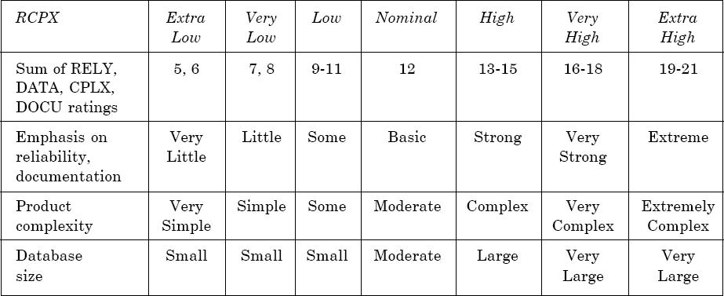
Software Project Planning
Product of cost drivers for early design model
i. Product Reliability and Complexity (RCPX): The cost driver combines four Post Architecture cost drivers which are RELY, DATA, CPLX and DOCU.

Slide 94
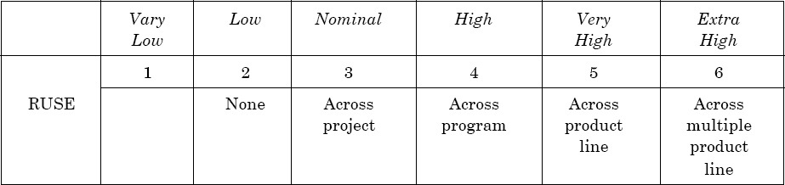
Software Project Planning
ii. Required Reuse (RUSE) : This early design model cost driver is same as its Post architecture Counterpart. The RUSE rating levels are (as per Table 16):

Slide 95
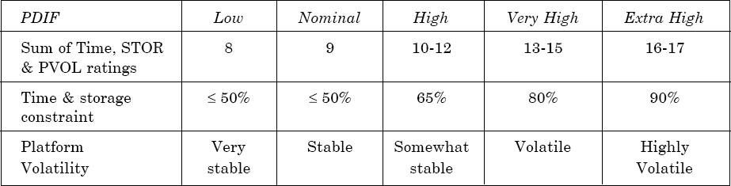
Software Project Planning
iii. Platform Difficulty (PDIF) : This cost driver combines TIME, STOR and PVOL of Post Architecture Cost Drivers.

Slide 96
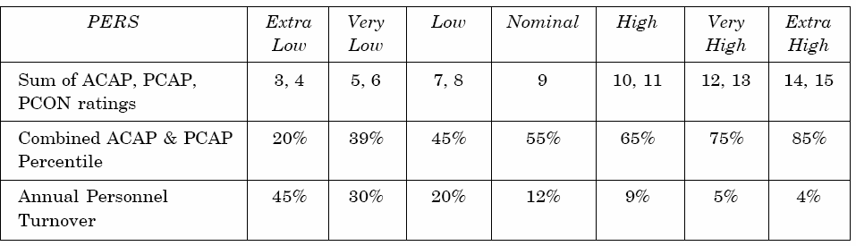
Software Project Planning
iv. Personnel Capability (PERS) : This cost driver combines three Post Architecture Cost Drivers. These drivers are ACAP, PCAP and PCON.

Slide 97
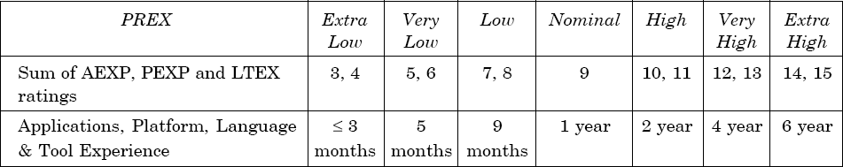
Software Project Planning
v. Personnel Experience (PREX) : This early design driver combines three Post Architecture Cost Drivers, which are AEXP, PEXP and LTEX.

Slide 98
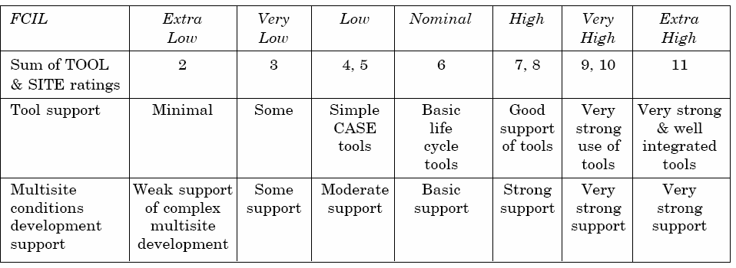
Software Project Planning
vi. Facilities (FCIL): This depends on two Post Architecture Cost Drivers, which are TOOL and SITE.

Slide 99
Software Project Planning
vii.Schedule (SCED) : This early design cost driver is the same as Post Architecture Counterpart and rating level are given below using table 16.
100

Slide 100
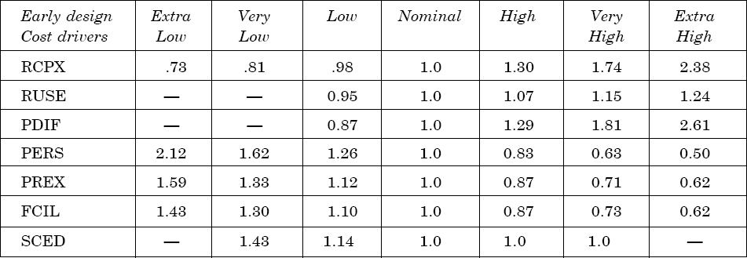
Software Project Planning
The seven early design cost drivers have been converted into numeric values with a Nominal value 1.0. These values are used for the calculation of a factor called “Effort multiplier” which is the product of all seven early design cost drivers. The numeric values are given in Table 15.
Table 15: Early design parameters
101

Slide 101
Software Project Planning
The early design model adjusts the nominal effort using 7 effort multipliers (EMs). Each effort multiplier (also called drivers) has 7 possible weights as given in Table 15. These factors are used for the calculation of adjusted effort as given below:
 
7
^{PM}adjusted ^{= PM} nominal × ∏ ^{EM}i 
 i=7 
PM_{adjusted} effort may very even up to 400% from PM_{nominal}
Hence PM_{adjusted} is the fine tuned value of effort in the early design phase
102

Slide 102
Software Project Planning
Example: 4.10
A software project of application generator category with estimated 50 KLOC has to be developed. The scale factor (B) has low precedentness, high development flexibility and low team cohesion. Other factors are nominal. The early design cost drivers like platform difficult (PDIF) and Personnel Capability (PERS) are high and others are nominal. Calculate the effort in person months for the development of the project.
103

Slide 103
Software Project Planning
Solution
Here
B = 0.91 + 0.01 * (Sum of rating on scaling factors for the project)
= 0.91 + 0.01 * (4.96 + 2.03 + 4.24 + 4.38 + 4.68)
= 0.91 + 0.01(20.29)=1.1129
PM_{nominal} = A*(size)^{B}
= 2.5 * (50)^{1.1129} = 194.41 Person months
The 7 cost drivers are
PDIF = high (1.29) PERS = high (0.83)
RCPX = nominal (1.0) RUSE = nominal (1.0) PREX = nominal (1.0) FCIL = nominal (1.0) SCEO = nominal (1.0)
104

Slide 104

Software Project Planning
= 194.41 * [1.29 x 0.83)
= 194.41 x 1.07
= 208.155 Person months
105

Slide 105
Software Project Planning
Post Architecture Model
The post architecture model is the most detailed estimation model and is intended to be used when a software life cycle architecture has been completed. This model is used in the development and maintenance of software products in the application generators, system integration or infrastructure sectors.
 17

^{PM}adjusted ^{= PM} nominal × ∏ ^{EM}i 
 i=7 
EM : Effort multiplier which is the product of 17 cost drivers.
The 17 cost drivers of the Post Architecture model are described in the table 16.
106

Slide 106
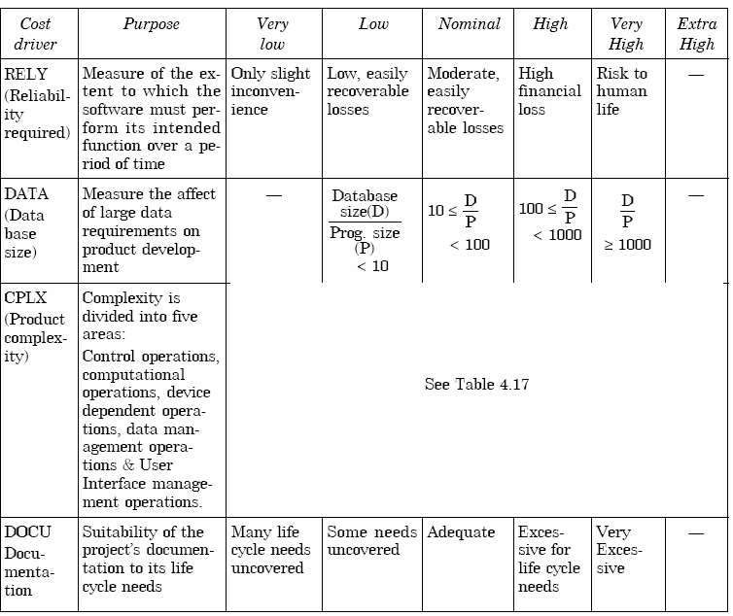
Software Project Planning
Table 16: Post Architecture Cost Driver rating level summary
Cont…
107

Slide 107
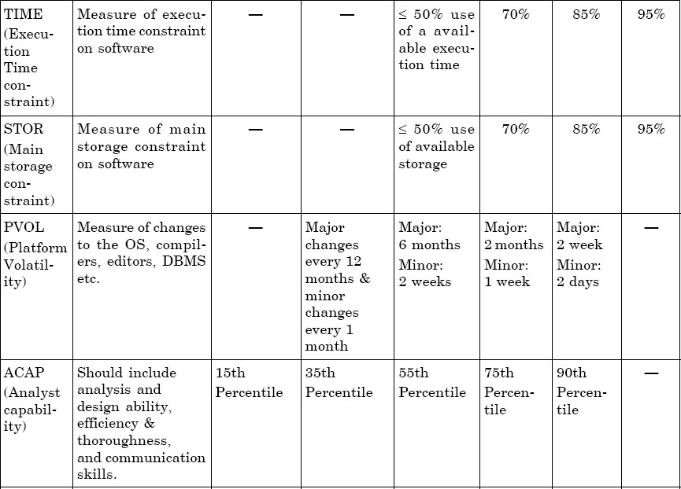
Software Project Planning
Table 16: Post Architecture Cost Driver rating level summary
Cont…
108

Slide 108
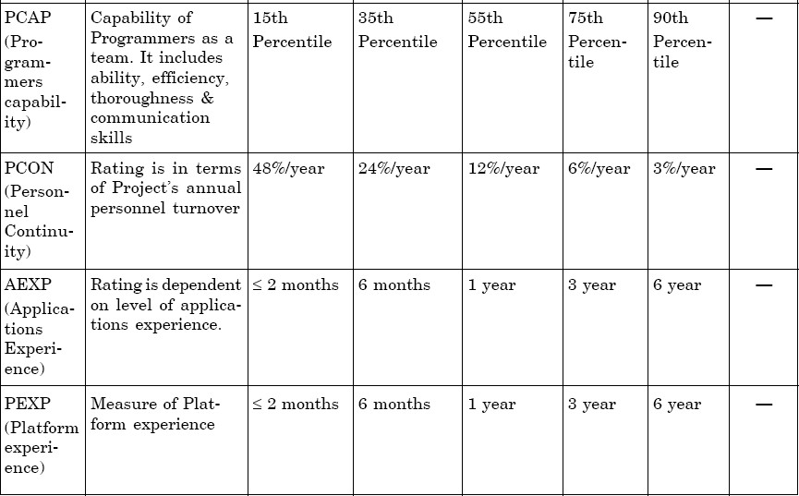
Software Project Planning
Table 16: Post Architecture Cost Driver rating level summary
Cont…
109

Slide 109
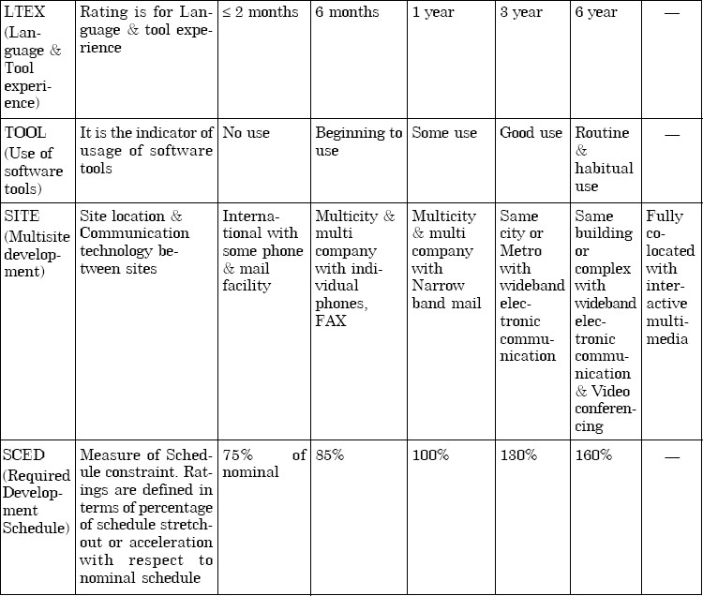
Software Project Planning
Table 16: Post Architecture Cost Driver rating level summary
110

Slide 110
Software Project Planning
Product complexity is based on control operations, computational operations, device dependent operations, data management operations and user interface management operations. Module complexity rating are given in table 17.
The numeric values of these 17 cost drivers are given in table 18 for the calculation of the product of efforts i.e., effort multiplier (EM). Hence PM adjusted is calculated which will be a better and fine tuned value of effort in person months.
111

Slide 111
Software Project Planning
 | Control Operations | Computational Operations | Device- dependent Operations | Data management Operations | User Interface Management Operations
Very | Straight-line code | Evaluation of | Simple read, | Simple arrays in | Simple input
Low | with a few non- | simple | write statements | main memory. | forms, report
 | nested structured | expressions: e.g., | with simple | Simple COTSDB | generators.
 | programming | A=B+C*(D-E) | formats. | queries, updates.
 | operators: Dos.
 | Simple module
 | composition via
 | procedure calls or
 | simple scripts.
Low | Straight forward | Evaluation of | No cognizance | Single file sub | User of simple
 | nesting of | moderate-level | needed of | setting with no data | graphics user
 | structured | expressions: e.g., | particular | structure changes, | interface (GUI)
 | programming | D=SQRT(B**2- | processor or I/O | no edits, no | builders.
 | operators. Mostly | 4*A*C) | device | intermediate files,
 | simple predicates |  | characteristics. | Moderately
 |  |  | I/O done at | complex COTS-DB
 |  |  | GET/PUT level. | queries, updates.
Table 17: Module complexity ratings
Software Engineering (3rd ed.), By K.K Aggarwal & Yogesh Singh, Copyright © New Age International Publishers, 2007
Cont…
112

Slide 112
Software Project Planning
 | Control Operations | Computational Operations | Device- dependent Operations | Data management Operations | User Interface Management Operations
Nominal | Mostly simple nesting. | Use of standard | I/O processing | Multi-file input | Simple use of
 | Some inter module | maths and | includes | and single file | widget set.
 | control Decision tables. | statistical | device | output. Simple
 | Simple callbacks or | routines. Basic | selection, | structural
 | message passing, | matrix/ vector | status | changes, simple
 | including middleware | operations. | checking and | edits. Complex
 | supported distributed |  | error | COTS-DB
 | processing. |  | processing. | queries,
 |  |  |  | updates.
High | Highly nested | Basic numerical | Operations at | Simple triggers | Widget set
 | structured | analysis: | physical I/O | activated by data | development
 | programming operators | multivariate | level (physical | stream contents. | and
 | with many compound | interpolation, | storage | Complex data | extension.
 | predicates. Queue and | ordinary | address | restructuring. | Simple voice
 | stack control. | differential | translations; |  | I/O
 | Homogeneous, | equations. Basic | seeks, read |  | multimedia.
 | distributed processing. | truncation, round | etc.)
 | Single processor soft | off concerns. | Optimized I/O
 | real time control. |  | overlap.
Table 17: Module complexity ratings
Software Engineering (3rd ed.), By K.K Aggarwal & Yogesh Singh, Copyright © New Age International Publishers, 2007
Cont…
113

Slide 113
Software Project Planning
 | Control Operations | Computational Operations | Device-dependent Operations | Data management Operations | User Interface Management Operations
Very | Reentrant and | Difficult but | Routines for | Distributed | Moderately
High | recursive coding. | structured | interrupt | database | complex
 | Fixed-priority | numerical analysis: | diagnosis, | coordination. | 2D/3D,
 | interrupt handling. | near singular | servicing, | Complex | dynamic
 | Task | matrix equations, | masking. | triggers. Search | graphics,
 | synchronization, | partial differential | Communication | optimization. | multimedia.
 | complex callbacks, | equations. Simple | line handling.
 | heterogeneous | parallelization. | Performance
 | distributed |  | intensive
 | processing. Single |  | embedded
 | processor hard real |  | systems.
 | time control.
Extra | Multiple resource | Difficult and | Device timing | Highly coupled, | Complex
High | scheduling with | unstructured | dependent coding, | dynamic | multimedia,
 | dynamically | numerical analysis: | micro | relational and | virtual reality.
 | changing priorities. | highly accurate | programmed | object
 | Microcode-level | analysis of noisy, | operations. | structures.
 | control. Distributed | stochastic data. | Performance | Natural
 | hard real time | Complex | critical embedded | language data
 | control. | parallelization. | systems. | management.
Table 17: Module complexity ratings
Software Engineering (3rd ed.), By K.K Aggarwal & Yogesh Singh, Copyright © New Age International Publishers, 2007
114

Slide 114
Software Project Planning
Cost Driver | Rating
 | Very Low | Low | Nominal | High | Very High | Extra High
RELY | 0.75 | 0.88 | 1.00 | 1.15 | 1.39
DATA |  | 0.93 | 1.00 | 1.09 | 1.19
CPLX | 0.75 | 0.88 | 1.00 | 1.15 | 1.30 | 1.66
RUSE |  | 0.91 | 1.00 | 1.14 | 1.29 | 1.49
DOCU | 0.89 | 0.95 | 1.00 | 1.06 | 1.13
TIME |  |  | 1.00 | 1.11 | 1.31 | 1.67
STOR |  |  | 1.00 | 1.06 | 1.21 | 1.57
PVOL |  | 0.87 | 1.00 | 1.15 | 1.30
ACAP | 1.50 | 1.22 | 1.00 | 0.83 | 0.67
PCAP | 1.37 | 1.16 | 1.00 | 0.87 | 0.74
Table 18: 17 Cost Drivers
Cont…
115

Slide 115
Software Project Planning
Cost Driver | Rating
 | Very Low | Low | Nominal | High | Very High | Extra High
PCON | 1.24 | 1.10 | 1.00 | 0.92 | 0.84
AEXP | 1.22 | 1.10 | 1.00 | 0.89 | 0.81
PEXP | 1.25 | 1.12 | 1.00 | 0.88 | 0.81
LTEX | 1.22 | 1.10 | 1.00 | 0.91 | 0.84
TOOL | 1.24 | 1.12 | 1.00 | 0.86 | 0.72
SITE | 1.25 | 1.10 | 1.00 | 0.92 | 0.84 | 0.78
SCED | 1.29 | 1.10 | 1.00 | 1.00 | 1.00
Table 18: 17 Cost Drivers
116

Slide 116
Software Project Planning
Schedule estimation
Development time can be calculated using PM_{adjusted} as a key factor and the desired equation is:
₎(0.28+0.2( B−0.091))]
SCED%
TDEV
= [φ × (PM
nominal adjusted
100
where Φ = constant, provisionally set to 3.67
TDEV_{nominal} = calendar time in months with a scheduled constraint B = Scaling factor
PM_{adjusted} = Estimated effort in Person months (after adjustment)
117

Slide 117
Software Project Planning
Size measurement
Size can be measured in any unit and the model can accordingly. However, COCOMO II details are:
be calibrated
Application composition model uses the size in object points.
The other two models use size in KLOC
Early design model uses unadjusted function points. These function points are converted into KLOC using Table 19. Post architecture model may compute KLOC after defining LOC counting rules. If function points are used, then use unadjusted function points and convert it into KLOC using Table 19.
118

Slide 118
Software Project Planning
Language | SLOC/UFP
Ada | 71
AI Shell | 49
APL | 32
Assembly | 320
Assembly (Macro) | 213
ANSI/Quick/Turbo Basic | 64
Basic-Compiled | 91
Basic-Interpreted | 128
C | 128
C++ | 29
Table 19: Converting function points to lines of code
Cont…₁₁₉
Software Engineering (3rd ed.), By K.K Aggarwal & Yogesh Singh, Copyright © New Age International Publishers, 2007

Slide 119
Software Project Planning
Language | SLOC/UFP
ANSI Cobol 85 | 91
Fortan 77 | 105
Forth | 64
Jovial | 105
Lisp | 64
Modula 2 | 80
Pascal | 91
Prolog | 64
Report Generator | 80
Spreadsheet | 6
Table 19: Converting function points to lines of code
120

Slide 120
Software Project Planning
Example: 4.11
Consider the software project given in example 4.10. Size and scale factor
(B) are the same. The identified 17 Cost drivers are high reliability (RELY), very high database size (DATA), high execution time constraint (TIME), very high analyst capability (ACAP), high programmers capability (PCAP). The other cost drivers are nominal. Calculate the effort in Person-Months for the development of the project.
121

Slide 121
Software Project Planning
Solution
B = 1.1129
= 194.41 Person-months
Here
^{PM}nominal
 17

^{= PM} nominal × ∏ ^{EM}i 
^{PM}adjusted
 i=7 
= 194.41 x (1.15 x 1.19 x 1.11 x 0.67 x 0.87)
= 194.41 x 0.885
= 172.05 Person-months
122

Slide 122












Software Project Planning
Putnam Resource Allocation Model
Norden of IBM
Rayleigh curve
Model for a range of hardware development projects.
Overall Curve Design and Coding
Persons
Time
Fig.6: The Rayleigh manpower loading curve
123

Slide 123
Software Project Planning
Putnam observed that | this | curve was | a close
approximation at project | level | and software | subsystem
level.
No. of projects = 150
124

Slide 124
Software Project Planning
The Norden / Rayleigh Curve
The curve is modeled by differential equation
m(t) = ^{dy} = 2kate^{−at 2}
--------- (1)
dt
dy
_{dt} = manpower utilization rate per unit time
a = parameter that affects the shape of the curve K = area under curve in the interval [0, ∞ ]
t = elapsed time
125

Slide 125
Software Project Planning
On Integration on interval [o, t]
y(t) = K [1-e^{-at2}] -------------(2)
Where y(t): cumulative manpower used upto time t.
y(0) = 0
y(∞) = k
The cumulative manpower is null at the start of the project, and grows monotonically towards the total effort K (area under the curve).
126

Slide 126
Software Project Planning
2
d y
2
= 2kae
−at
2
[1− 2at ] = 0
dt ²
_{t} 2
₌ 1
d
2a
“t_{d}”: time where maximum effort rate occurs Replace “t_{d}” for t in equation (2)

_{t} 2


d
2
E = y (t ) = k 1 − e
2 t
d
 = K (1 − e ^{− 0.5} )




E = y (t ) = 0.3935 k
1
a =
2t ²
d
127

Slide 127
Software Project Planning
1
Replace “a” with
in the Norden/Rayleigh model. By
2t ²
d
making this substitution in equation we have
_{t} 2
2K
−
m(t) =
te
2t ²
d
2t ²
d
_{t} 2
K
−
=
te
2t
2
d
_{t} 2
d
128

Slide 128
Software Project Planning
a=2
a=0.5
a=0.222
m (t) Person
a=0.125
Time (years)
Fig.7: Influence of parameter ‘a’ on the manpower
distribution
129

Slide 129
Software Project Planning
At time t=t_{d}, peak manning m (t_{d}) is obtained and denoted by m_{o}.
k
m =
o
t_{d} e
k t_{d} m₀ e
= Total project cost/effort in person-years.
= Delivery time in years
= No. of persons employed at the peak
= 2.71828
130

Slide 130
Software Project Planning
Example: 4.12
A software development project is planned to cost 95 MY in a period of 1 year and 9 months. Calculate the peak manning and average rate of software team build up.
131

Slide 131
Software Project Planning
Solution
Software development cost Peak development time
k=95 MY
t_{d} = 1.75 years
k
Peak manning
m_{o}=
t e
d
95
= 32.94 = 33 persons
1.75×1.648
Average rate of software team build up
m₀
= =
33
= 18.8 persons / year or 1.56 person / month
t_{d} 1.75
132

Slide 132
Software Project Planning
Example: 4.13
Consider a large-scale project for which the manpower requirement is K=600 PY and the development time is 3 years 6 months.
Calculate the peak manning and peak time.
What is the manpower cost after 1 year and 2 months?
133

Slide 133
Software Project Planning
Solution
(a) We know t_{d}=3 years and 6 months = 3.5 years
₌ K t_{d} e
NOW
m
0
∴ m₀ =
600/(3.5x1.648) ≅ 104 persons
134

Slide 134
y(t) = K [1− e^{−at 2} ]
Software Project Planning
(b) We know
t = 1 year and 2 months
= 1.17 years
1 1
a =
= = 0.041
2t ²
2 × (3.5)²
d
y (1.17 ) = 600 [1 − e ^{− 0.041 (1.17 ) 2} ]
= 32.6 PY
135

Slide 135
Software Project Planning
Difficulty Metric
Slope of manpower distribution curve at start time t=0 has some useful properties.
2
d y
m'(t) = = 2kae
−at
2
2
(1− 2at )
dt ²
Then, for t=0
m'(0) = 2Ka = ^{2K} = ^{K}
_{t} 2
2t ²
d
d
136

Slide 136
Software Project Planning
K
The ratio is called difficulty and denoted by D,
_{t} 2
d
which is measured in person/year :
k
D=
_{t}2
persons/year
d
137

Slide 137
Software Project Planning
Project is difficult to develop if
Manpower demand is high
When time schedule is short
138

Slide 138
Software Project Planning
Peak manning is defined as:
k
m =
0
t_{d} e
e
D = ^{k} = ^{m0}
_{t} 2
t
d d
Thus difficult projects tend to have a higher peak manning for a given development time, which is in line with Norden’s observations relative to the parameter “a”.
139

Slide 139
Software Project Planning
Manpower buildup
D is dependent upon “K”. The derivative of D relative to “K” and “t_{d}” are
D'(t ) = ^{−2k} persons / year ²
d
_{t} 3
d
D'(k) = ¹ year ⁻²
_{t} 2
d
140

Slide 140
Software Project Planning
D¹(K) will always be very much smaller than the absolute value of D¹(t_{d}). This difference in sensitivity is shown by considering two projects
Project A Project B
: Cost = 20 PY & t_{d} = 1 year
: Cost = 120 PY & t_{d} = 2.5 years
The derivative values are
Project A Project B
: D` (t_{d}) = -40 & D`(K) = 1
: D` (t_{d}) = -15.36 & D`(K) = 0.16
This shows that a given software development is time sensitive.
141

Slide 141
Software Project Planning
Putnam observed that
Difficulty derivative relative to time
Behavior of s/w development
If project scale is increased, the development time also
increase to such an extent that
k
remains constant
_{t} 3
d
around a value which could be 8,15,27.
142

Slide 142
Software Project Planning
It is represented by D₀ and can be expressed as:
D = ^{k} person / year ²
0
_{t} 3
d
D₀ =8, new s/w with many interfaces & interactions with other systems.
D₀ =15, New standalone system.
D₀ =27, The software is rebuild form existing software.
143

Slide 143
Software Project Planning
Example: 4.14
Consider the example 4.13 and calculate the difficulty and manpower build up.
144

Slide 144
Software Project Planning
Solution
We know
D = ^{K}
Difficulty
_{t} 2
d
600
=
= 49 person / year
(3.5)²
Manpower build up can be calculated by following equation
D = ^{K}
0
_{t} 3
d
600
=
= 14 person / year ²
(3.5)³
145

Slide 145
Software Project Planning
Productivity Versus Difficulty
Productivity = No. of LOC developed per person-month
P ∞ D^{β}
Avg. productivity
LOC produced
P =
cumulative manpower used to produce code
146

Slide 146
Software Project Planning
P = S/E
_{P = φD}−2 / 3
S = φD^{−2 / 3} E
= φD^{−2 / 3} (0.3935 K )
₋ 2
3
 k 
S = φ
 
k (0.3935)
t
2
 d 
S = 0.3935φ K ^{1/ 3}t_{d}
4 / 3
147

Slide 147
Software Project Planning
0.39φ
c
Technology Factor
Hardware constraints
Experience
Programming environment
Complexity
148

Slide 148
Software Project Planning
C
610 – 57314
K : P-Y
T : Years
1/ 3 _{4 / 3}
S = CK
t_{d}
−1/ 3 _{−4 / 3}
C = S.K
t_{d}
The trade off of time versus cost
_{K} 1/ 3_{t} 4 / 3 _{= S / C}
d
1  S

3
K =


4
t _{d}

C

149

Slide 149
Software Project Planning
C = 5000
S = 5,00,000 LOC
K = ¹ (100 )³
_{t} 4
d
t_{d} (years) | K (P-Y)
5.0 | 1600
4.0 | 3906
3.5 | 6664
3.0 | 12346
Table 20: (Manpower versus development time)
150

Slide 150
Software Project Planning
Development Subcycle
All that has been discussed so far is related to project life cycle as represented by project curve
Manpower
distribution
Project
Design code development
Test & Validation
Requirements & Specification
Maintenance
Fig.8: Project life cycle
Time
151

Slide 151
Software Project Planning
Project life cycle
Project curve is the addition of two curves
Development Curve
Test & Validation Curve
152

Slide 152
Software Project Planning
∴ m_{d} (t) = 2k_{d}bt e^{-bt2} y_{d} (t) = K_{d} [1-e^{-bt2}]
An examination of m_{d}(t) function shows a non-zero value of m_{d} at time t_{d}.
This is because the manpower involved in design & coding is still completing this activity after t^{d} in form of rework due to the validation of the product.
Nevertheless, for the model, a level of completion has to be assumed for development.
It is assumed that 95% of the development will be completed by the time t_{d}.
153

Slide 153
Software Project Planning
y_{d} (t)
−bt²
= 1− e = 0.95
K_{d}
1
∴We may say that
b =
2t ²
od
T_{od}: time at which development curve exhibits a peak manning.
t _{d}
t =
od
6
154

Slide 154
Software Project Planning
Relationship between K_{d} & K must be established.
At the time of origin, both cycles have the same slope.
 dm  dm
 
 
= ^{K} = ^{Kd} =
d
 
2
2
 dt _{o} t_{d}
dt
^{t}od
 _{o}
K_{d}=K/6
₌ K _{d}
D = ^{K}
_{t} 2 _{t} 2
d
od
155

Slide 155
Software Project Planning
This does not apply to the manpower build up D₀.
K_{d}
D = ^{K} =
o
_{t} 3
6t ³
d
od
Conte investigated that Larger projects
Medium & small projects
reasonable overestimate
156

Slide 156
Software Project Planning
Example: 4.15
A software development requires 90 PY during the total development sub-cycle. The development time is planned for a duration of 3 years and 5 months
Calculate the manpower cost expended until development time
Determine the development peak time
Calculate the difficulty and manpower build up.
157

Slide 157
Software Project Planning
Solution
(a) Duration t_{d} = 3.41 years
y_{d} (t) _{= 1− e} ^{−bt}d
We know from equation
= 0.95
K_{d}
^{yd (td )} = 0.95
K_{d}
Y_{d} (t_{d} ) = 0.95× 90
= 85.5 PY
158

Slide 158
Software Project Planning
t _{d}
(b) We know from equation
^{t}od
=
6
t _{d}
t =
= 3 .41 / 2 .449 = 1 .39 years
od
6
≅ 17 months
159

Slide 159
Software Project Planning
(c) Total Manpower development
K_{d} = y_{d} (t_{d} ) / 0.95
= 85.5 / 0.95 = 90
K = 6K_{d} = 90× 6 = 540PY
D = K / t ² = 540 /(3.41)² = 46 ^{persons/years}
d
D = ^{K} = 540 /(3.41)³ = 13.6
persons/years²
o
_{t} 3
d
160

Slide 160
Software Project Planning
Example:4.16
A software development for avionics has consumed 32 PY up to development cycle and produced a size of 48000 LOC. The development of project was completed in 25 months. Calculate the development time, total manpower requirement, development peak time, difficulty, manpower build up and technology factor.
161

Slide 161
Software Project Planning
Solution:
Development time t_{d} = 25 months = 2.08 years
Total manpower development
k = ^{Yd (td )} = ³² = 33.7 PY
d
0.95 0.95
Development peak time
t = ^{(td )} = 0.85 years = 10 months
od
6
K = 6K_{d} = 6 x 33.7 = 202 PY
202
D = ^{k} =
= 46.7 pesons / years
_{t} 2
(2.08)²
d
162

Slide 162
Software Project Planning
202
D = ^{k} =
= 22.5 Persons / year ²
0
_{t} 3
(2.08)³
d
Technology factor
C = SK ^{−1/ 3}t ^{−4 / 3}
d
= 3077
163

Slide 163
Software Project Planning
Example 4.17
What amount of software can be delivered in 1 year 10 months in an organization whose technology factor is 2400 if a total of 25 PY is permitted for development effort.
164

Slide 164
Software Project Planning
Solution:
t_{d} = 1.8 years K_{d} = 25 PY
K = 25 x 6 = 150 PY
C = 2400
S = CK
1 / 3 _{t} 4 / 3
d
We know
= 2400 x 5.313 x 2.18 = 27920 LOC
165

Slide 165
Software Project Planning
Example 4.18
The software development organization developing real time software has been assessed at technology factor of 2200. The maximum value of manpower build up for this type of software is D_{o}=7.5. The estimated size to be developed is S=55000 LOC.
(a) Determine the total development development manpower cost, the
time, difficulty
the total and the
development peak manning.
(b) The development time determined in (a) is considered too long. It is recommended that it be reduced by two months. What would happen?
166

Slide 166
Software Project Planning
Solution
We have
S = CK ^{1/ 3}t ^{4 / 3}
d
3
 s 
 
= kt ⁴
 c 
d
 S 
3
which is also equivalent to
 
= D t ⁷
 C 
o d
1/ 7
 _{1  S }³ 
then
t_{d} = 
  
 ^{D}0  ^{C}  
167

Slide 167
Software Project Planning
Since ^{S} = 25
C
t_{d} = 3 years
K = D t³ = 7.5× 27 = 202 PY
0 d
202
Total development manpower cost K_{d} =
=33.75PY
06
D = D₀t_{d} = 22.5 persons / year
₌ t_{d} 3
t
= = 1.2 years
od
6 6
168

Slide 168
Software Project Planning
2
M_{d}(t) = 2k_{d} bte^{-bt}
2
Y_{d}(t) = k_{d} (1-e^{-bt} )
t = t_{od}
Here
_{e}−1/ 2
Peak manning = m_{od} = Dt
od
= 22.5 x 1.2 x .606
= 16 persons
169

Slide 169
Software Project Planning
III. If development time is reduced by 2 months
Developing s/w at higher manpower build-up
Producing less software
170

Slide 170
Software Project Planning
(i) Increase Manpower Build-up
3
₌ 1  S 
D
₇  
o
t_{d}
 C 
Now t_{d} = 3 years – 2 months = 2.8 years
D_{o} = (25)³ /(2.8)⁷ = 11.6 persons / years
k = D t³ = 254 PY
0 d
K = ²⁵⁴ = 42.4 PY
d
6
171

Slide 171
Software Project Planning
D = D₀t_{d} = 32.5 persons / year
The peak time is Peak manning
t_{od} = 1.14 years m_{od} = Dt_{od} e^{-0.5}
= 32.5 x 1.14 x 0.6
= 22 persons
Note the huge increase in peak manning & manpower cost.
172

Slide 172
Software Project Planning
(ii) Produce Less Software
 S 
3
 
= D t ⁷ = 7.5× (2.8)⁷ = 10119.696
 C 
0 d
 S 
3
 
= 21.62989
 C 
C=2200 S=47586 LOC
Then for
173

Slide 173
Productivity versus difficult
Example 4.19
A stand alone project for which the size is estimated at 12500 LOC is to be developed in an environment such that the technology factor is 1200. Choosing a manpower build up D_{o}=15, Calculate the minimum development time, total development man power cost, the difficulty, the peak manning, the development peak time, and the development productivity.
174

Slide 174
Software Project Planning
Solution
Size (S)
Technology factor (C) Manpower buildup (D_{o})
Now
= 12500 LOC
= 1200
= 15
_{S = CK} 1/ 3_{t} 4 / 3
d
^{S} _{= K}1/ 3_{t} 4 / 3
C
d
 S 
3
 
= Kt ⁴
 C 
d
175

Slide 175
Software Project Planning
₌ K
Also we know D
_{t} 3
o
d
K = D t³ = D t³
o d o d

S

3
Hence
 
= Dt
7
C
o d
 12500 
3
Substituting the values, we get
 
= 15t ⁷
 1200 
d
(10.416)³ ^{1/ 7}
t_{d} = 

15
 
t_{d} = 1.85 years
176

Slide 176
Software Project Planning
(i) Hence Minimum development time (t_{d})=1.85 years
₌ K
(ii) Total development manpower cost
K
d
6
Hence K =15t³
d
=15(1.85)³=94.97 PY
K = ^{K} = ^{94.97} = 15.83 PY
d
6 6
(iii) Difficulty
94.97
D = ^{K} =
= 27.75 Persons / year
_{t} 2
(1.85)²
d
177

Slide 177
Software Project Planning
K
(iv) Peak Manning
m =
0
t_{d} e
94.97
=
=31.15Person
1.85×1.648
₌ t_{d}
(v) Development Peak time
t
od
6
₌ 1.85
= 0.755 years
2.449
178

Slide 178
Software Project Planning
(vi) Development Productivity
No .of lines of code ( S )
effort ( K _{d} )
=
= ¹²⁵⁰⁰ = 789.6 LOC / PY
15.83
179

Slide 179
Software Project Planning
Software Risk Management
We Software developers are extremely optimists.
We assume, everything will go exactly as planned.
Other view
not possible to predict what is going to happen ?
Software surprises Never good news
180

Slide 180
Software Project Planning
Risk factor
management is required to reduce this surprise
Dealing with concern before it becomes a crisis.
Quantify probability of failure & consequences of failure.
181

Slide 181
Software Project Planning
What is risk ?
Tomorrow’s problems are today’s risks.
“Risk is a problem that may cause some loss or threaten the success of the project, but which has not happened yet”.
182

Slide 182
Software Project Planning
Risk management is the process of identifying addressing and eliminating these problems before they can damage the project.
Current problems &
Potential Problems
183

Slide 183
Software Project Planning
Typical Software Risk
Capers Jones has identified the top five risk factors that threaten projects in different applications.
Dependencies on outside agencies or factors.
Availability of trained, experienced persons
Inter group dependencies
Customer-Furnished items or information
Internal & external subcontractor relationships
184

Slide 184
Software Project Planning
2.
Requirement issues
Uncertain requirements
Wrong product
or
Right product badly
Either situation results in unpleasant unhappy customers.
surprises and
185

Slide 185
Software Project Planning
Lack of clear product vision
Lack of agreement on product requirements
Unprioritized requirements
New market with uncertain needs
Rapidly changing requirements
Inadequate Impact analysis of requirements changes
186

Slide 186
Software Project Planning
3. Management Issues
Project managers plans, and most
usually write the risk management people do not wish to air their
weaknesses in public.
Inadequate planning
Inadequate visibility into actual project status
Unclear project ownership and decision making
Staff personality conflicts
Unrealistic expectation
Poor communication
187

Slide 187
Software Project Planning
4.
Lack of knowledge
Inadequate training
Poor understanding of methods, tools, and techniques
Inadequate application domain experience
New Technologies
Ineffective, poorly processes
documented or neglected
188

Slide 188
Software Project Planning
5.
Other risk categories
Unavailability of adequate testing facilities
Turnover of essential personnel
Unachievable performance requirements
Technical approaches that may not work
189

Slide 189
Software Project Planning
Risk Management Activities
Risk Identification
Risk Assessment
Risk Analysis
Risk Prioritization
Risk Management
Risk Management Planning
Risk Control
Risk Monitoring
Fig. 9: Risk Management Activities
Risk Resolution
190

Slide 190
Software Project Planning
Risk Assessment
Identification of risks
Risk analysis involves examining how project outcomes might change with modification of risk input variables.
Risk prioritization focus for severe risks.
Risk exposure: It is the product of the probability of incurring a loss due to the risk and the potential magnitude of that loss.
191

Slide 191
Software Project Planning
Another way of handling risk is the risk avoidance. Do not do the risky things! We may avoid risks by not undertaking certain projects, or by relying on proven rather than cutting edge technologies.
192

Slide 192
Software Project Planning
Risk Control
Risk Management Planning produces a plan for dealing with each significant risks.
Record decision in the plan.
Risk resolution is the execution of the plans of dealing with each risk.
193

Slide 193
Multiple Choice Questions
Note: Choose most appropriate answer of the following questions:
4.1 After the finalization of SRS, we may like to estimate
(a) Size
(c) Development time
(b) Cost
(d) All of the above.
4.2 Which one is not a size measure for software
(a) LOC
(c) Cyclomatic Complexity
(b) Function Count
(d) Halstead’s program length
4.3 Function count method was developed by
(a) B.Beizer
(c) M.halstead
(b) B.Boehm
(d) Alan Albrecht
4.4 Function point analysis (FPA) method decomposes the system into functional units. The total number of functional units are
(a) 2
(c) 4
(b) 5
(d) 1
194

Slide 194
Multiple Choice Questions
IFPUG stand for
Initial function point uniform group
International function point uniform group
International function point user group
Initial function point user group
Function point can be calculated by
(a) UFP * CAF
(c) UFP * Cost
(b) UFP * FAC
(d) UFP * Productivity
Putnam resource allocation model is based on
Function points
Norden/ Rayleigh curve
Putnam theory of software management
Boehm’s observation on manpower utilisation rate
Manpower buildup for Putnam resource allocation model is
K / t ² persons / year ² (b) K / t ³ persons / year ²
d d
(c) K / t ² persons / year (d ) K / t ³ persons / year
d d
195

Slide 195
Multiple Choice Questions
COCOMO was developed initially by
B.W.Bohem
(c) B.Beizer
A COCOMO model is
Common Cost estimation model
Constructive cost Estimation model
Complete cost estimation model
(b) Gregg Rothermal
(d) Rajiv Gupta
(d) Comprehensive Cost estimation model
4.11 Estimation of software development effort for organic software is COCOMO is
(a) E=2.4(KLOC)^{1.05}PM
(c) E=2.0(KLOC)^{1.05}PM
(b) E=3.4(KLOC)^{1.06}PM
(d) E-2.4(KLOC)^{1.07}PM
4.12 Estimation of size for a project is dependent on
(a) Cost
(c) Time
(b) Schedule
(d) None of the above
4.13 In function point analysis, number of Complexity adjustment factor are
(a) 10
(c) 14
(b) 20
(d) 12
196

Slide 196
Multiple Choice Questions
4.14 COCOMO-II estimation model is based on
(a) Complex approach
(c) Bottom up approach
(b) Algorithm approach
(d) Top down approach
4.15 Cost estimation for a project may include
(a) Software Cost
(c) Personnel Costs
(b) Hardware Cost
(d) All of the above
4.16 In COCOMO model, if project size is typically 2-50 KLOC, then which mode is to be selected?
(a) Organic
(c) Embedded
COCOMO-II was developed at
University of Maryland
(c) IBM
(b) Semidetached
(d) None of the above
(b) University of Southern California
(d) AT & T Bell labs
4.18 Which one is not a Category of COCOMO-II
(a) End User Programming
(c) Requirement Sector
(b) Infrastructure Sector
(d) System Integration
197

Slide 197
Multiple Choice Questions
4.19 Which one is not an infrastructure software?
(a) Operating system
(c) Compilers
(b) Database management system
(d) Result management system
How many stages are in COCOMO-II?
2
(c) 4
(b) 3
(d) 5
Which one is not a stage of COCOMO-II?
Application Composition estimation model
Early design estimation model
Post architecture estimation model
Comprehensive cost estimation model
In Putnam resource allocation model, Rayleigh curve is modeled by the equation
2
(a) m(t) = 2at e^{−at}
2
(c) m(t) = 2Kat e^{−at}
2
(b) m(t) = 2Kt e^{−at}
2
(d ) m(t) = 2Kbt e^{−at}
198

Slide 198
Multiple Choice Questions
4.23 In Putnam resource allocation model, technology factor ‘C’ is defined as
_{(a) C = SK} −1/ 3_{t} −4 / 3
(b) C = SK^{1/ 3}t ^{4 / 3}
d
d
(c) C = SK ^{1/ 3}t ^{−4 / 3}
(d ) C = SK ^{−1/ 3}t ^{4 / 3}
d
d
Risk management activities are divided in
3 Categories
(c) 5 Categories
(b) 2 Categories
(d) 10 Categories
4.25 Which one is not a risk management activity?
(a) Risk assessment
(c) Risk generation
(b) Risk control
(d) None of the above
199

Slide 199
Exercises
What are various activities during software project planning?
Describe any two software size estimation techniques.
A proposal is made to count the size of ‘C’ programs by number of semicolons, except those occurring with literal strings. Discuss the strengths and weaknesses to this size measure when compared with the lines of code count.
Design a LOC counter for counting LOC automatically. Is it language dependent? What are the limitations of such a counter?
Compute the function point value for a project with the following information domain characteristics.
Number of user inputs = 30 Number of user outputs = 42 Number of user enquiries = 08 Number of files = 07
Number of external interfaces = 6
Assume that all complexity adjustment values are moderate.
200

Slide 200
Exercises
4.6 Explain the concept of function points. acceptable in industry?
Why FPs are becoming
What are the size metrics? How is function point metric advantageous over LOC metric? Explain.
Is it possible to estimate software size before coding? Justify your answer with suitable example.
Describe the Albrecht’s function count method with a suitable example.
Compute the function point FP for a payroll program that reads a file of employee and a file of information for the current month and prints cheque for all the employees. The program is capable of handling an interactive command to print an individually requested cheque immediately.
201

Slide 201
Exercises
Assume that the previous payroll program is expected to read a file containing information about all the cheques that have been printed. The file is supposed to be printed and also used by the program next time it is run, to produce a report that compares payroll expenses of the current month with those of the previous month. Compute functions points for this program. Justify the difference between the function points of this program and previous one by considering how the complexity of the program is affected by adding the requirement of interfacing with another application (in this case, itself).
Explain the Walson & Felix model and compare with the SEL model.
The size of a software product to be developed has been estimated to be 22000 LOC. Predict the manpower cost (effort) by Walston-Felix Model and SEL model.
A database system is to be developed. The effort has been estimated to be 100 Persons-Months. Calculate the number of lines of code and productivity in LOC/Person-Month.
202

Slide 202
Exercises
Discuss various types of COCOMO mode. Explain the phase wise distribution of effort.
Explain all the levels of COCOMO model. Assume that the size of an organic software product has been estimated to be 32,000 lines of code. Determine the effort required to developed the software product and the nominal development time.
Using the basic COCOMO model, under all three operating modes, determine the performance relation for the ratio of delivered source code lines per person-month of effort. Determine the reasonableness of this relation for several types of software projects.
The effort distribution for a 240 KLOC organic mode software development project is: product design 12%, detailed design 24%, code and unit test 36%, integrate and test 28%. How would the following changes, from low to high, affect the phase distribution of effort and the total effort: analyst capability, use of modern programming languages, required reliability, requirements volatility?
203

Slide 203
Exercises
Specify, design, and develop a program that implements COCOMO. Using reference as a guide, extend the program so that it can be used as a planning tool.
Suppose a system for office automation is to be designed. It is clear from requirements that there will be five modules of size 0.5 KLOC, 1.5 KLOC, 2.0 KLOC, 1.0 KLOC and 2.0 KLOC respectively. Complexity, and reliability requirements are high. Programmer’s capability and experience is low. All other factors are of nominal rating. Use COCOMO model to determine overall cost and schedule estimates. Also calculate the cost and schedule estimates for different phases.
Suppose that a project was estimated to be 600 KLOC. Calculate the effort and development time for each of the three modes i.e., organic, semidetached and embedded.
Explain the COCOMO-II in detail. What types of categories of projects are identified?
204

Slide 204
Exercises
Discuss the Infrastructure Sector of COCOMO-II.
Describe various stages of COCOMO-II. Which stage is more popular and why?
A software project of application generator category with estimated size of 100 KLOC has to be developed. The scale factor (B) has high percedentness, high development flexibility. Other factors are nominal. The cost drivers are high reliability, medium database size, high Personnel capability, high analyst capability. The other cost drivers are nominal. Calculate the effort in Person-Months for the development of the project.
Explain the Putnam resource allocation model. What are the limitations of this model?
Describe the trade-off between time versus cost in Putnam resource allocation model.
Discuss the Putnam resources allocation model. Derive the time and effort equations.
205

Slide 205
Exercises
Assuming the Putnam model, with S=100,000 , C=5000, D_{o}=15, Compute development time t_{d} and manpower development K_{d}.
Obtain software productivity data for two or three software development programs. Use several cost estimating models discussed in this chapter. How to the results compare with actual project results?
It seems odd that cost and size estimates are developed during software project planning-before detailed software requirements analysis or design has been conducted. Why do we think this is done? Are there circumstances when it should not be done?
Discuss typical software risks. How staff turnover problem affects software projects?
What are risk management activities? Is it possible to prioritize the risk?
206

Slide 206
Exercises
What is risk exposure? What techniques can be used to control each risk?
What is risk? Is it economical to do risk management? What is the effect of this activity on the overall cost of the project?
There are significant risks even in student projects. Analyze a student project and list all the risk.
207

